Slide 1
ECE 4180 Final Project: Balancing Buddy
Daniel Niemann, Fan Han Hoon, Sid Gulati, Muath F Alsubhi

Slide 2
Project Introduction
Primary Objective:
Construct a robot from already-owned parts that can autonomously maintain its balance in real time with zero help
Challenges Encountered:
Sensitivity of selected IMU
We went through 4 different IMUs before landing on our final choice
Off-axis center of gravity
Due to servo placement
Issues with balancing calculation
Wild distribution of results
A library used for IMU was found to be flawed

Slide 3
Hardware Overview
IMU of Choice: LSM9DS0
Use Mbed instead of Arduino or Pi Zero
Lots of libraries that were already available + familiarity with the platform
IMU
LSM9DS0
Angular Acceleration
Mbed
LPC1768
Gyro Reading
Power (5V)
Power (5V)
Speed (PWM)
Direction
Left Motor
AA Batteries
H-Bridge
TB6612FNG
Balancing
Robot!
Power (5V)
Right Motor

Slide 4
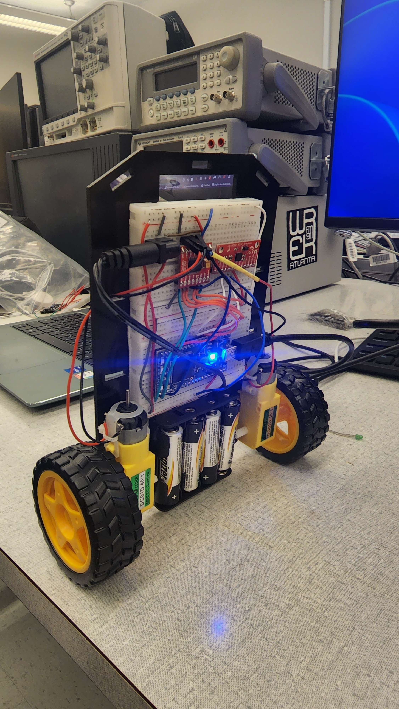
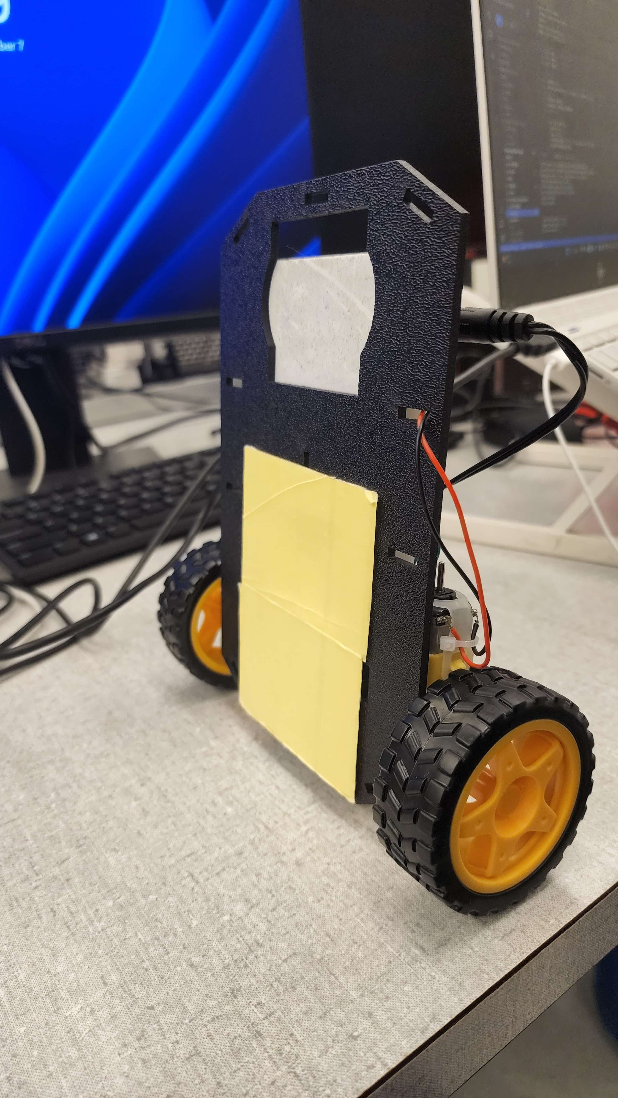
IMU: LSM9DS0
Reads gyro and accelerometer data and sends to Mbed
Since the balancing point is in front of the chassis due to servo placement, all weight was placed on the front of the device to create a balancing point for the device that lets it stand straight up
H-Bridge: TB6612FNG
Takes input from Mbed and scales servo power accordingly
Mbed: LPC1768
Runs balancing software, reads IMU and controls servos
Dual Servo Motors
Driven by mbed code through H-bridge
Power Supply (5V)
4 AA batteries in parallel allow for long battery life

Slide 5
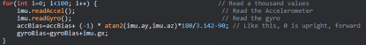
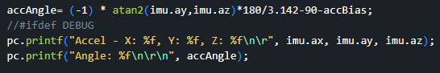
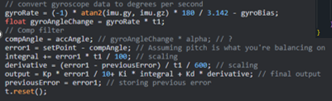
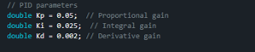
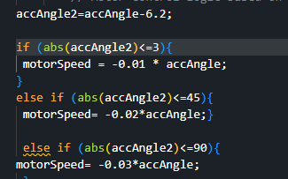
Software & Programming
Motor Code (Identify Motor Bias)
Rev/s, Linear Speed, Time
Heading Angle
Bias
2 Mode
Equilibrium Mode (Identify IMU Bias)
Balancing Mode (PID Control)

Slide 6
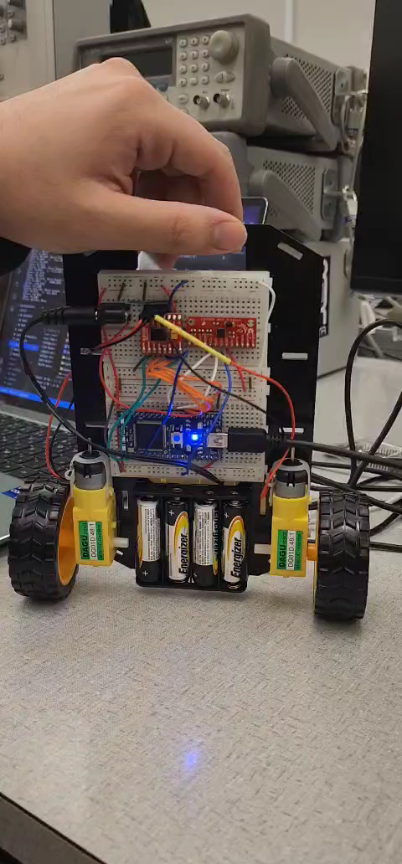
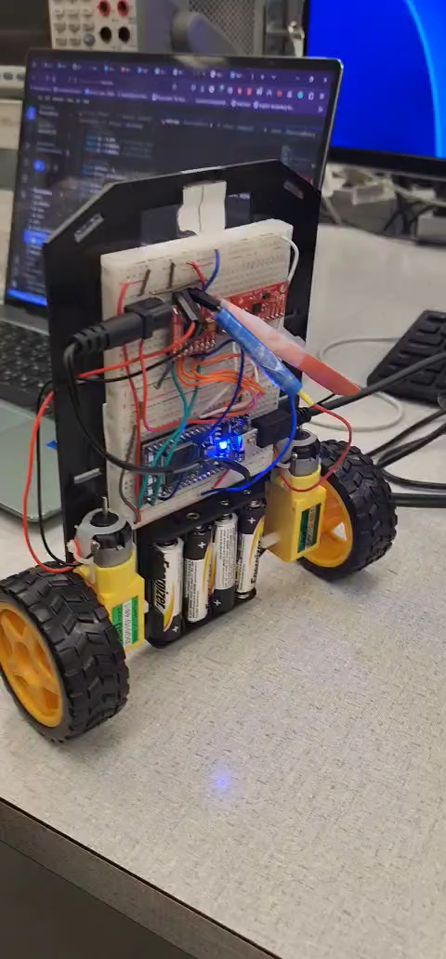
Demo

Slide 7
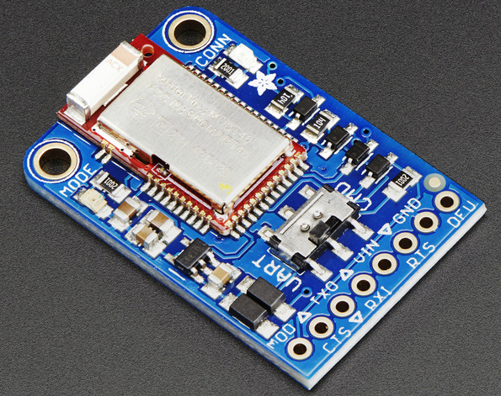
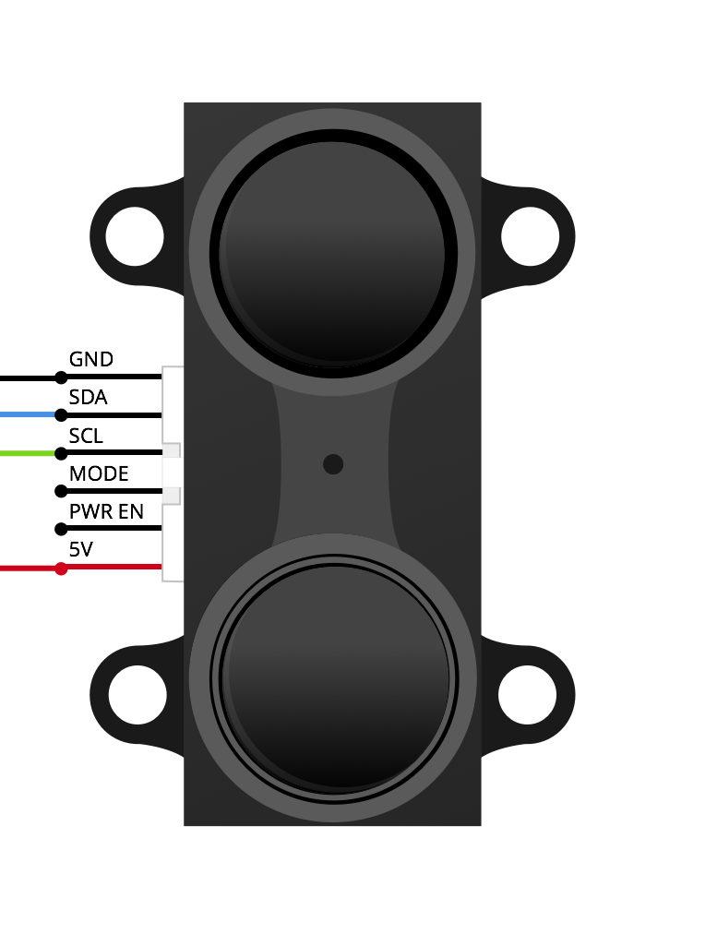
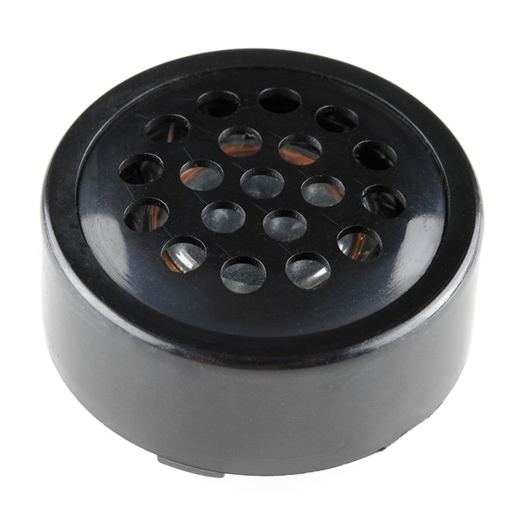
Summary & Future Work
In the static balance test, the robot performed exceptionally
Robot encountered small hiccups with dynamic balance test
Sometimes, servo would overcommit once the robot tilted past 50 degrees in either direction
Future Additions:
Bluetooth module with virtual joystick to control device
Lidar sensor to sense objects in robot’s path
Speaker to play funny music

